Slide 1
Development Toolchain
Fabian Schmidt

Slide 2

Who am I?
Fabian Schmidt
9+ years Project Server & SharePoint developer
Developer @ Sensei Project Solutions

Slide 3
What is my motivation?
Requests for usage enhancements
Customer Environments
Fast cadence of changes
Secret stash on consultant computer
Notes:
Office 365 usage ramped up in past 2 years
Request for usage enhancements
Often small work packages
Small work package: between 1 day and 1 week effort.
Customers have similar issues
Reusability is necessary
Reusability much easier in Office365.
Support for SharePoint web templating
Special of Project is to use SharePoint site templates for Project workspaces. Solution must be part of the template.
Customer Situation
Office 365 (SharePoint Online / Project Online)
SharePoint & Project Server 2013
often without app isolation
SharePoint & Project Server 2010
Fast cadence: O365 changes. Deployment to prod daily / hourly.

Slide 4
Journey
SharePoint developer bubble
How others solve these issues?
Hunt for the ultimate toolchain
Notes:
Question: Who is a SharePoint developer?
Open Source Development
-over one year ago starting hunting for OSS best practices.
-Mainly web developers
SharePoint developer bubble
Crusty toolchain
Windows only
Development on SharePoint Server local only
Hard to automate
Few Add in model usages
How others solve these issues?
Re-usable extension
Rapid Development
Continuous build
Continuous delivery
Release automation
Deployment automation
Hunting for Open Source Software toolchain
GitHub is your friend
Cherry picking
Good support by community
Cherry picking be careful too much good stuff.

Slide 5
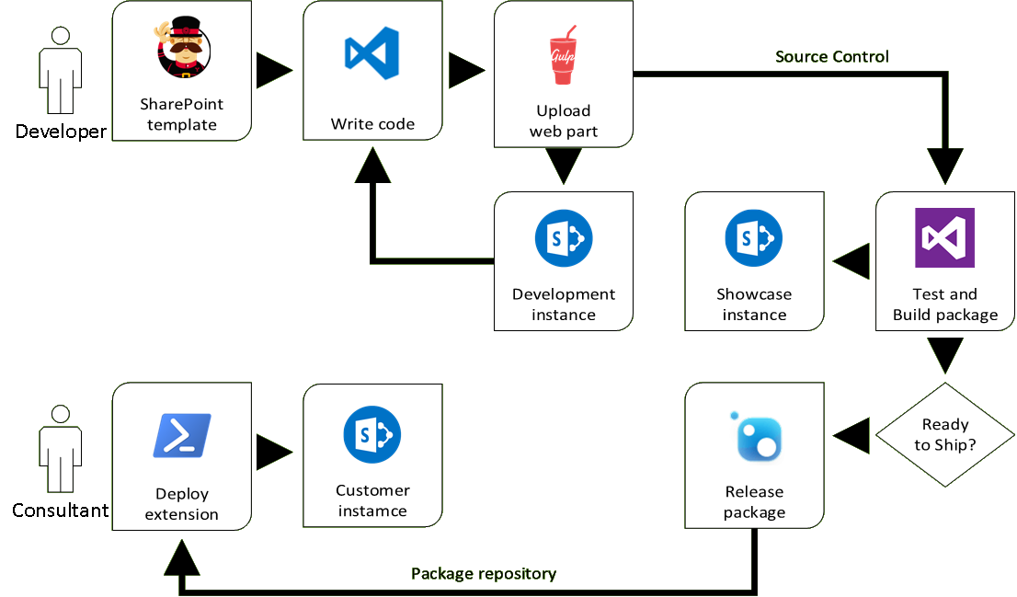
Overview
Notes:
Developer:
Yeoman (Node JS - templating tool) to create project based on template.
Writing in VS Code
Gulp (Nodes JS – Task runner) to
Type script compile
Combine and minimize files
Upload to SharePoint Online
Development in a separate SharePoint Online Dev instance.
Source Control VSTS
Auto deploy to a SharePoint Online Showcase instance.
Release via VSTS Release manager to a package repository.
Consultant small static PowerShell to deploy package.

Slide 6

Buzzword Bingo
Re-usable extension
Rapid Development
Continuous build
Continuous delivery
Release automation
Deployment automation
Notes:
Re-usable extension with same code base 2010, 2013, O365.
Spend less time writing code
Automate build
Have latest extension version auto deploy to staging
Formal release of changes. Check changes before release.
Make latest version available to consultants
Minimize overhead of Winword, PDF and user interaction.

Slide 7
Rapid Development
2016 web developer
Open Source
MORE Frameworks
Notes:
Make live easy for a developer.
Use tools for normal web site development. => Many people use them.

Slide 8
New web part
demonstration

Slide 9
Continuous *
Continuous integration
Continuous delivery
Continuous deployment
Notes:
Cover 3 minutes to let build finish.
Associate changes with task is recommendation. Makes life later easier. At least meaningful comments.
Change is small. Especially in GIT. Usually an hour of work. Only a few files.
Test driven development :
For demo excluded
JavaScript no exclusion.
If JavaScript fails and page does not work user does not care why.
Heaps of Frameworks available
Deploy after build :
Environment : Latest / Staging
For testing and showcase
Release Manager:
See changes since last release.
Setup deferred approval
Can be completely automated

Slide 10
Continuous build Continuous delivery in action
demonstration

Slide 11
Deployment
Consultant access
Minimal requirements
KISS
Notes:
SharePoint access: no admin only site collection
Requires:
Internet access
Access to target SharePoint
WMF5.0 / Windows 10

Slide 12
Consume feed
demonstration

Slide 13
Overview
Notes:
Developer:
Yeoman (Node JS - templating tool) to create project based on template.
Writing in VS Code
Gulp (Nodes JS – Task runner) to
Type script compile
Combine and minimize files
Upload to SharePoint Online
Development in a separate SharePoint Online Dev instance.
Source Control VSTS
Auto deploy to a SharePoint Online Showcase instance.
Release via VSTS Release manager to a package repository.
Consultant small static PowerShell to deploy package.

Slide 14
Conclusion
Minimize time to build extension
Minimize time to roll out extension
Versatile
Concentrate on the work
No stash of old versions
Only free services and tools are used
Notes:
I have used it to learn state of the art toolchain for web development
SharePoint (On Premises) has history of mediocre Toolchain.
This uses Open source which is actively developed by a lot of people.
From bug fixed to available for everybody 5 minutes
On Error Roll forward instead of Roll back
Showed Web Part. Also used for JSScriptlink (extension run all pages).
Concentrate => less hassle
No wallet was hurt for this presentation.
SharePoint Framework compare:
Same ingredients → Make yourself comfortable with them
Focused on mobile first
First release Q4 2016
My solution
Compatibility first
Now

Slide 15
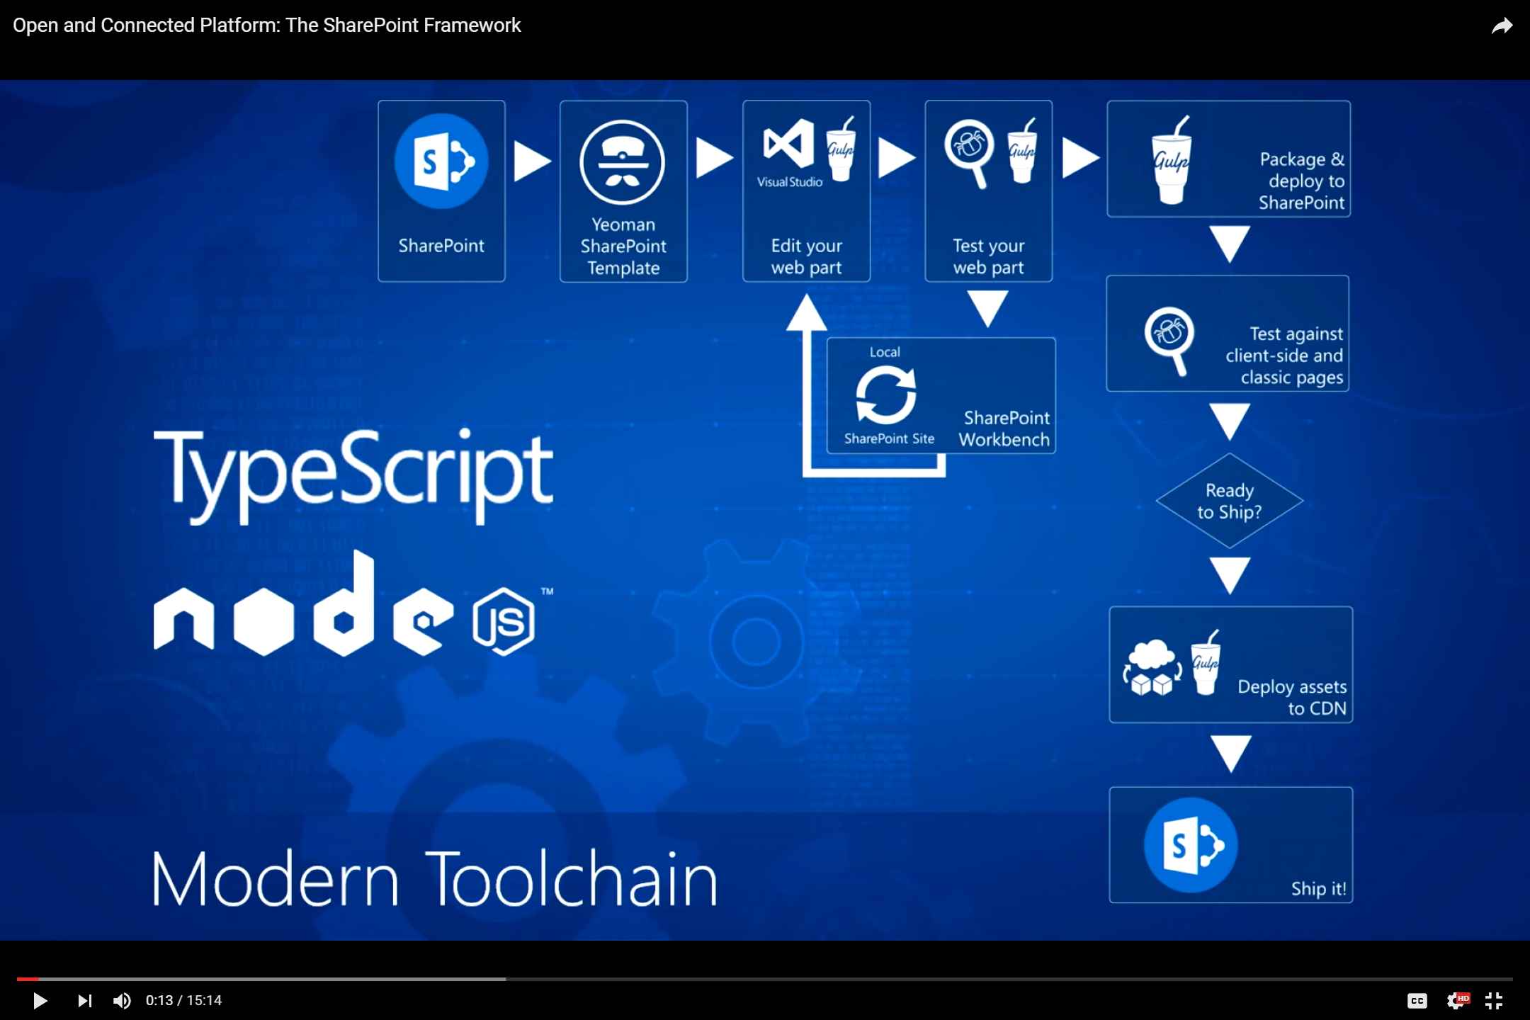
This is a slide
Notes:
Source:
http://youtu.be/T_bGyqKwT4g

Slide 16
Question and Answer

Slide 17
Questions?
Comments?
More info
Contact details:
Fabian Schmidt Fabian@Schmidtie.net
Related links:
https://github.com/Fabian-Schmidt/SharePoint-Toolchain/

Slide 18
Thanks for listening
Remember to submit your feedback so you go in the draw to win prizes at the end of the day

Slide 19
This is a slide
This is just another slide
No bullets used for content
Simple fonts and colours

Slide 20
Name of the demo
demonstration

Slide 21
Content highlight
Feel free to use slides like this to help add emphasis and showcase content where it makes sense to do so

Slide 22
Focus on content
Try to keep the ‘shiny’ factor to a minimum
Use slides to back up what your talking about, not be the main event

Slide 23
For the developers
function UseThisSlideForCode()
{
var brian = new ModernBogan(“Brian Farnhill”);
if (brian.status == Status.Bored)
{
return Tasks.PlayXbox;
}
return Tasks.WorkOnSlideTemplate;
}

